Slide 1

MIXINS

Slide 2
Topics
Mixins
Examples

Slide 3
What is it?
Mixins are a way of reusing a class’s code in multiple class hierarchies.
To use a mixins, use the with keyword followed by one or more mixin names.

Slide 4
Example
class car{
int doors()=>4;
String color()=>'black';
void playMusic(){
for(int i=0;i<3;i++){
print('Sa Re Ga Ma Pa Da Ni Sa');
}
}
}
class truck{
bool has4x4()=>true;
bool hasBed()=>true;
int doors()=>2;
String color()=>'red';
void honkTheHorn()
{
print("HORN");
}}

Slide 5
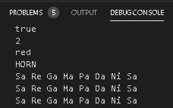
import 'mix.dart';
import 'truck.dart';
class suv extends car with truck{
}
import 'package:mix/suv.dart';
void main(List<String> arguments) {
suv jeep=new suv();
print(jeep.has4x4());
print(jeep.doors());
print(jeep.color());
jeep.honkTheHorn();
jeep.playMusic();
}

Slide 6
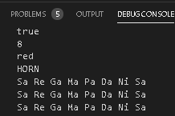
class lemo{
int doors()=>8;
String color()=>'red';
}
import 'mix.dart';
import 'truck.dart';
import 'package:mix/lemo.dart';
class suv extends car with truck, lemo{
}
import 'package:mix/suv.dart';
void main(List<String> arguments) {
suv jeep=new suv();
print(jeep.has4x4());
print(jeep.doors());
print(jeep.color());
jeep.honkTheHorn();
jeep.playMusic();
}

Slide 7
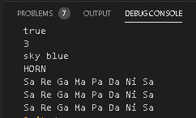
import 'mix.dart';
import 'truck.dart';
import 'package:mix/lemo.dart';
class suv extends car with truck, lemo{
String color()=>'sky blue';
int doors()=>3;
}
import 'package:mix/suv.dart';
void main(List<String> arguments) {
suv jeep=new suv();
print(jeep.has4x4());
print(jeep.doors());
print(jeep.color());
jeep.honkTheHord();
jeep.playMusic();
}

Slide 8
Thank You

